Slide 1

ACHARYA INSTITUTE OF TECHNOLOGY
DEPARTMENT OF COMPUTER SCIENCE & ENGINEERING
(Affiliated to Visvesvaraya Technological University, Belagavi, Approved by AICTE, New Delhi and Accredited by NBA & NAAC)
Acharya Dr. Sarvepalli Radhakrishnan Road, Achitnagar Post, Soladevanahalli, BENGALURU – 560107
MINPROJECT SYNOPSIS (21CSMP67)
Presentation on
“AI-GENERATED BLOG”
Presented by: Under the guidance of:
1. Anish Kumar(1AY21CS028) Dr. Ajith Padyana,
2. Aditya Jyothi Sahu (1AY21CS017) Professor and Head,
3. Dalavai Hruday (1AY21CS049) Department of CS&E

Slide 2
AGENDA
Emotion-Based Content Generation.
Subscription Management.
Creating precise title and content.
Effective management of contents that are created.

Slide 3
INTRODUCTION TO THE PROJECT

Slide 4
INTRODUCTION
1.1. problem definition:
The SaaS AI-Generated Blog for Creators is a platform designed to help content creators generate blog content in various emotional tones.
1.2. overview of the technical area:
Next JS: Frontend framework for building the user interface.
AuthO: Manages user authentication and authorization.
MongoDB: Database for storing user data and generated content.
Stripe: Payment gateway for processing payments and managing subscriptions.
Chat GPT Open AI (gpt-3.5-turbo): AI model for generating blog content.
React Native: For building mobile applications (if applicable).

Slide 5
1.3. overview of existing system:
AI Writing Assistant-
AI Writing Assistant, created by Copymatic and available from the Semrush App Center, is robust. Its 76 tools help you generate copy for emails, blogs, CTAs, web content, social media posts, ads, video scripts, product descriptions, and even job descriptions.
Free Title Generator
Free Title Generator, designed by Semrush, does exactly what it says: generates a variety of titles, or headlines.
Drawbacks of existing Systems
Costly
Only generates titles
Heavily focused on SEO improvement instead of writing improvement

Slide 6
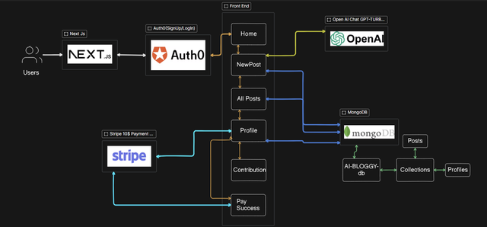
1.4. overview of proposed system:

Slide 7
Getting Started
Sign Up: Register for an account on the platform.
Log In: Use AuthO to log in securely.
Select Emotional Tone: Choose the desired emotional tone for your blog post.
Generate Content: Input relevant information and let the AI generate the blog content.
Manage Subscription: Use Stripe to handle your subscription and billing information.
User Authentication and Authorization
AuthO is used to manage user authentication and authorization. It ensures that only registered users can access the platform and its features.
Payment Processing
Stripe is integrated into the platform to handle payment processing and subscription management. Users can subscribe to different plans and manage their billing information through Stripe.
Content Generation
Chat GPT Open AI (gpt-3.5-turbo) is utilized to generate blog content based on the specified emotional tone. Users can select the desired tone and input relevant information to create personalized blog posts.
Target Audience
The primary target audience for this platform includes content creators who wish to generate blog posts with specific emotional tones to engage their audience effectively.

Slide 8
The platform supports the following emotional tones for blog content:
Sad
Happy
Angry
Neutral
Professional
objectives of the proposed system
We have build the service, it in such a way that the content that we can generate are SEO friendly and Great content what the user needs
They can generate content in any emotion tone(happy, sad, angry, formal) what the user needs.

Slide 9
REQUIREMENTS SPECIFICATION

Slide 10
FUNCTIONAL REQUIREMENTS
Next JS: Frontend framework for building the user interface.
AuthO: Manages user authentication and authorization.
MongoDB: Database for storing user data and generated content.
Stripe: Payment gateway for processing payments and managing subscriptions.
Chat GPT Open AI (gpt-3.5-turbo): AI model for generating blog content.
React Native: For building mobile applications (if applicable).

Slide 11
REFERENCES
[1] https://docs.stripe.com/
[2] https://platform.openai.com/docs/overview
[3] https://auth0.com/docs
[4] https://www.mongodb.com/docs/atlas/
[5] https://nextjs.org/docs

Slide 12
THANK YOU

